Slide 1
William M. Finch
Elementary School
GO TEAM MEETING
February 9th, 2023
Notes:
Good Morning/Afternoon! Today we begin the process of planning our school’s budget for FY23. I know we are all here for the same reason and that is ensuring success for all (enter school name) students. This meeting is to provide an overview of the draft budget and for you to give feedback on the draft budget.

Slide 2
GO TEAM MEMBERS 2022-2023
NAME | ROLE
Dr. Tara Spencer | Principal
Ms. Ieshia Freeman | Parent
Ms. Melinda Malone | Parent
Ms. Terrion Moody | Parent
Ms. Nartasha Smith-Willis | Staff
Ms. Seggee Davis | Staff
Ms. Erin Gore | Staff
Ms. Terra Washington | Community Member
Mr. Terry Lee | Community Member
Ms. Wanda Washington | Swing Seat
Roll Call

Slide 3
Action Items
.
Approval of Agenda
Approval of Previous Minutes
Action Items

Slide 4
William M. Finch Elementary School FY 24 Budget Feedback Meeting

Slide 5
Norms
This is a meeting of the GO Team. Only members of the team may participate in the discussion. Any members of the public present are here to quietly observe.
We will follow the agenda as noticed to the public and stay on task.
We invite and welcome contributions of every member and listen to each other.
We will respect all ideas and assume good intentions.

Slide 6
GO Team Budget Development Process
YOUR SCHOOL STRATEGIC PLAN…
is your roadmap and your role.
It is your direction, your priorities, your vision, your present, your future.
Step 1: Data Review
Step 2: Strategic Plan Review
Step 3: Budget Parameters
(Strategic Priorities)
Step 4: Budget Choices
Notes:
Today I will provide an overview of the budget allocations for FY23. We will begin the work of funding the strategic priorities we agreed upon during our strategic review meeting. (IF YOU HAVE NOT DECIDED ON YOUR PRIORITIES, YOU WILL SAY – WE WILL DECIDE ON OUR PRIORITIES AND THEN DISCUSS ALLOCATING FUNDS TO ADDRESS THOSE PRIORITIES).

Slide 7
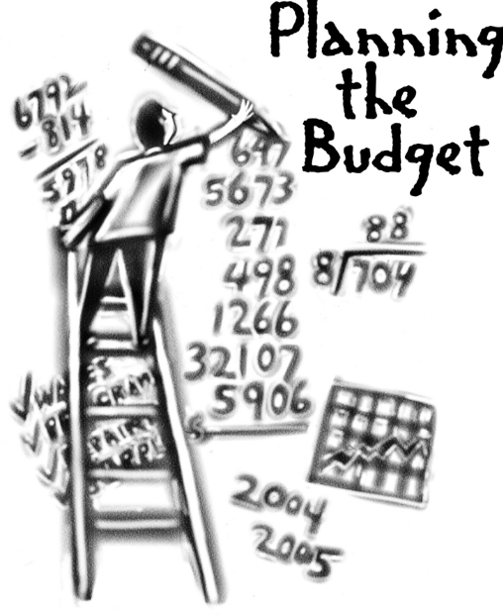
Overview of FY ‘24 GO Team Budget Process
Step 1 Review and Update Strategic Plan and Rank Strategic Priorities
By end of Fall Semester
Step 6 Principals: HR Staffing Conferences Begin
Late February – Early March
Step 3 GO Team Initial Budget Session: Allocation
January 24 – early February
Step 7 GO Team Final Budget Approval Meeting
Budgets Approved by March 17
Step 5
GO Team Feedback Session: Draft Budget Presented & Discussed February – multiple meetings, if necessary
Step 4 Principals: Associate Supt. Discussions and Review
February (supports needed, specific challenges, coaching)
Step 2 Principals: Workshop FY 24 Budget
January 24
GO Teams are encouraged to have ongoing conversations

Slide 8
Budget Feedback Meetings
What
The GO Team feedback session(s) should be scheduled for the principal to provide an overview of the school’s draft budget for the GO Team members and the general public.
Why
This meeting provides an opportunity for GO Teams to discuss how the school’s budget has been allocated to support the programmatic needs and key strategic priorities.
When
Meetings must be held in February before staffing conferences. May be combined with the allocation meeting (as needed), if the GO Team has completed strategic plan updates and ranked strategic priorities.
Notes:
Looking for general consensus prior to Staffing Conferences

Slide 9
FY24 Budget Parameters
FY24 School Priorities | Rationale
Focus on Reading and Math as a foundational skill; Ensure students reach content mastery. | Secure foundational skills in literacy and math are crucial for students' success in college, career, and life and are considered key enablers of equity.
Ensure students are exposed to STE(A)M and work to obtain state certification by 2025. | STEAM inspires inquiry and curiosity; it empowers students to ask thought-provoking questions that promote creativity and exploration. Students are able to connect their problem-solving to real-world solutions.
Improve teacher efficacy and growth mindedness. | Teachers' self-efficacy, namely teachers' beliefs in their ability to effectively handle the tasks, obligations, and challenges related to their professional activity, plays a key role in influencing important academic outcomes
Notes:
Review the priorities that the GO Team has developed and the rationale for these priorities. Feel free to copy this slide if you have more than 3 priorities to account for.

Slide 10
FY24 Budget Parameters
FY24 School Priorities | Rationale
Improve leadership capacity and build opportunities. | Leadership capacity is the ability to reflect on the way in which you lead to develop more effective ways to get results.
Build systems and resources to support the school’s priorities. | Ensure that students are receiving maximized opportunities for achievement and remediation daily
Inform and engage the school’s families and communities. | Research shows that parent engagement in schools is closely linked to better student behavior, higher academic achievement, and enhanced social skills.
Create a safe, nurturing and caring culture for all students. | Safe and nurturing environments help to improve scholars' academic performance, curtail bullying, reduce dropout rates, and build character.
Notes:
Review the priorities that the GO Team has developed and the rationale for these priorities.

Slide 11
Descriptions of Strategic Plan
Breakout Categories
Priorities: FY24 funding priorities from the school’s strategic plan, ranked by the order of importance.
APS Five Focus Area: What part of the APS Five is the priority aligned to?
Strategies: Lays out specific objectives for schools improvement.
Request: “The Ask” What needs to be funded in order to support the strategy?
Amount: What is the cost associated with the Request?

Slide 12
FY24 Strategic Plan Break-out
Priorities | APS FIVE Focus Area | Strategies | Requests | Amount
Focus on Reading and Math as a foundational skill; Ensure students reach content mastery. | Data Driven Practices Curriculum and Instruction | Intervene early so that students are successful with literacy and numeracy. | Purchase 2 EIP Teachers | $90,919 x2 = $181, 838
Ensure students are exposed to STE(A)M and work to obtain state certification by 2025. | Signature Programming | Ensure students receive exposure to STEAM and work to support integration of STEAM competencies throughout the day. | Increase FTE from .5 to 1.0 | $45, 459
Improve teacher efficacy and growth mindedness. | Curriculum and Instruction | Utilize flexible learning tools, technology integration, and targeted instruction to personalize learning for all students | Ensure teachers/staff receive job-embedded professional learning | $22,500 (Stipends) $7,500 (Contracted Svcs)
Notes:
For the next few slides, I will show you how I have allocated the budget to support our strategic priorities.
Based on our strategic priorities and funds we received, here is a break-out of the priorities, which focus area it addresses, the strategies that will be implemented, the purchase request, which funding source was used and the amount.

Slide 13
Plan for FY24 Leveling Reserve
Priorities | APS FIVE Focus Area | Strategies | Requests | Amount
Focus on Reading and Math as a foundational skill; Ensure students reach content mastery. | Curriculum & Instruction | Implement rigorous, culturally relevant, and linguistically responsive Reading and Math curriculum with fidelity in all core content areas and instructional best practices in Tier 1 instruction | Instructional Supplies Expendable Equipment | $60,000
Notes:
For the next few slides, I will show you how I have allocated the budget to support our strategic priorities.
Based on our strategic priorities and funds we received, here is a break-out of the priorities, which focus area it addresses, the strategies that will be implemented, the purchase request, which funding source was used and the amount.

Slide 14
Plan for FY24 Title I Holdback & Family Engagement Funds
Priorities | APS FIVE Focus Area | Strategies | Requests | Amount
Inform and engage the school’s families and community | Whole Child Intervention | Increase parent engagement, awareness, and knowledge-base as valued stakeholders through fluid communication and active participation of the school’s Parent Liaison | Funding for Family Engagements | $6,000
Notes:
For the next few slides, I will show you how I have allocated the budget to support our strategic priorities.
Based on our strategic priorities and funds we received, here is a break-out of the priorities, which focus area it addresses, the strategies that will be implemented, the purchase request, which funding source was used and the amount.

Slide 15
Plan for FY24 CARES Allocation
Priorities | APS FIVE Focus Area | Strategies | Requests | Amount
Ensure students reach content mastery in Reading & Math. | Curriculum & Instruction | Intervene early so that students are successful with literacy and numeracy | Purchase and Hourly Tutor Ensure Instructional Supplies | $45,000
Notes:
For the next few slides, I will show you how I have allocated the budget to support our strategic priorities.
Based on our strategic priorities and funds we received, here is a break-out of the priorities, which focus area it addresses, the strategies that will be implemented, the purchase request, which funding source was used and the amount.

Slide 16
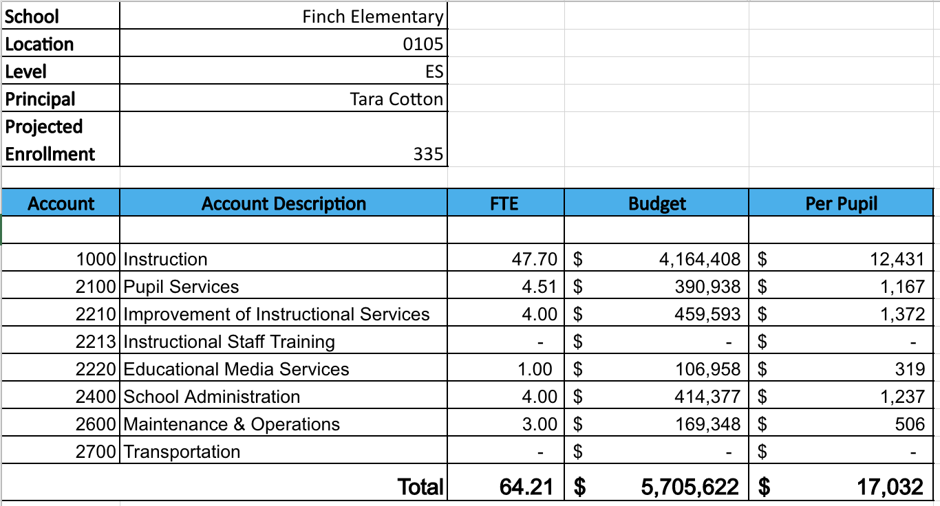
Budget by Function
*Based on Current Allocation of School Budget
Notes:
I am passing out the definitions for these funding categories. You will see what makes up each category. Although the school’s total budget amount will not change, allocation per function may change depending on our conversations and school needs.

Slide 17
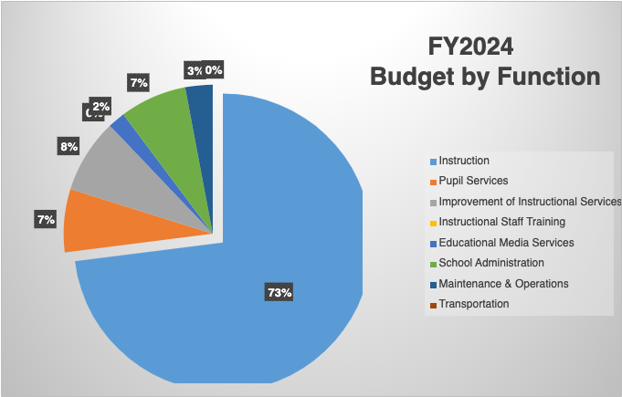
Budget by Function
*Based on Current Allocation of School Budget
Notes:
Explain the pie chart and allocations

Slide 18
Questions for the GO Team to Consider and Discuss
Are our school’s priorities (from your strategic plan) reflected in this budget?
Are new positions and/or resources included in the budget to address our major priorities?
Do we know (as a team) the plan to support implementation of these priorities beyond the budget (ex. What strategies will be implemented)?
What tradeoffs are being made in order to support these priorities?
How are district and cluster priorities reflected in our budget?
Cluster priorities- what staff, materials, etc. are dedicated to supporting our cluster’s priorities?
Signature programs- what staff, materials, etc. are dedicated to supporting our signature program?
Are there positions our school will share with another school, i.e. nurse, counselor?
Notes:
CHAIR - Our final task for today! Here are questions that we need to consider to ensure we have a good working draft budget. Let’s walk through them together.

Slide 19
Where We’re Going?
Our next meeting is the Budget Approval Meeting
What:
During this meeting we will review the budget, which should be updated based on feedback from the staffing conference, Associate Superintendents, and key leaders. After review, GO Teams will need to take action (i.e., vote) on the FY24 Budget.
Why:
Principals will present the final budget recommendations for GO Team approval.
When:
All approval meetings must be held after staffing conferences. Budgets must be approved by March 17th.

Slide 20
Announcements and Upcoming Events
GO TEAM Declaration of Candidacy- OPEN NOW- February 28th
Visit APS Strong Schools
PBIS Incentives for Students- February 9th
Student Achievement Parade/Pep Rally- February 10th
Winter Recess for Students- February 20th- February 24th
Winter Recess for Staff- February 21st- February 24th
Next Meeting- March 2nd, 2023 @ 3:30PM

Slide 21
Thank you

